Slide 1

Routers & OPNsense Firewall
A guide to setting it up and using basic configurations

Slide 2
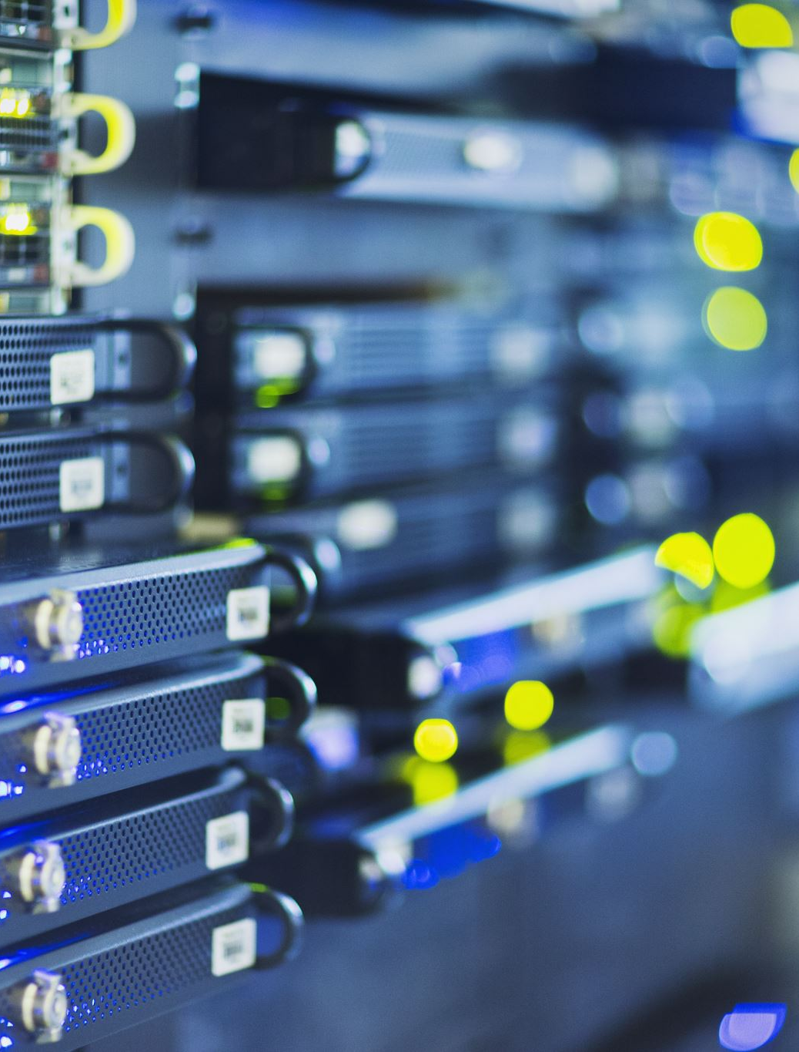
What is a Router?

Slide 3
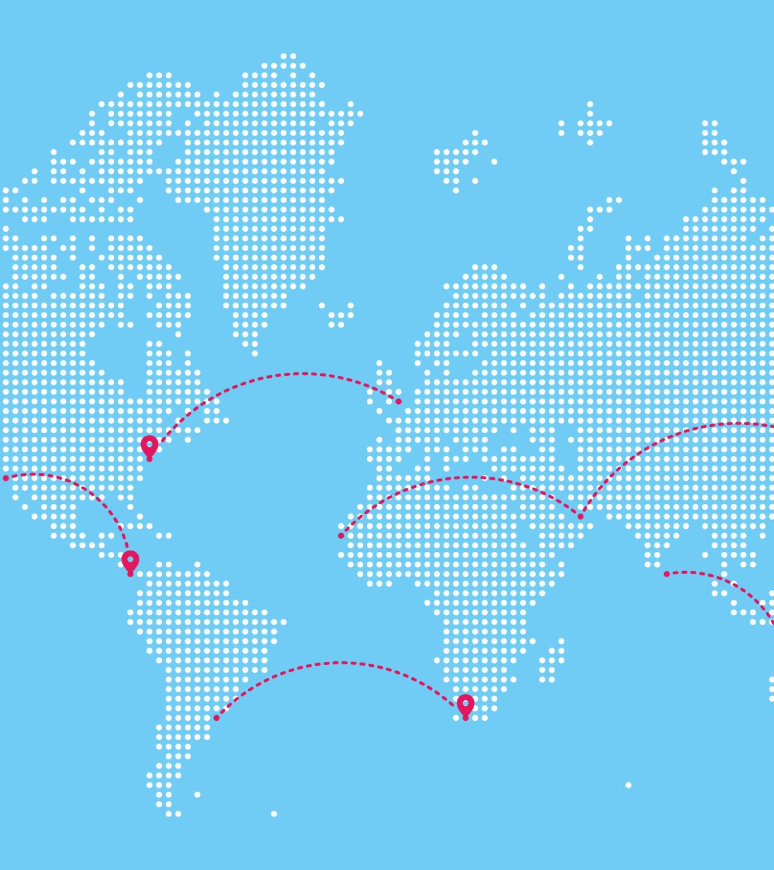
Function:
Routers: Devices that guide data over the internet.
🌐 Function: Analyze data packets to determine the most efficient path.
📨 Analogy: Similar to how postal services determine routes for letters/packages based on destination addresses.

Slide 4
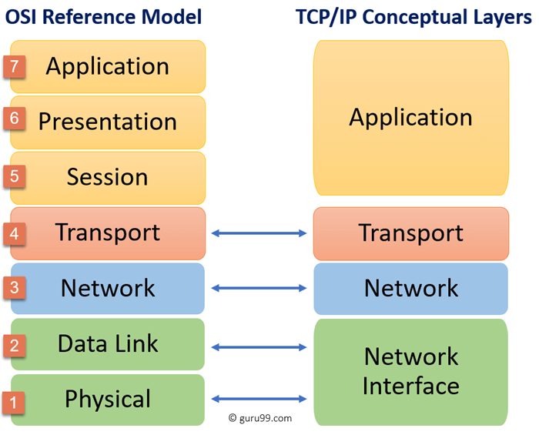
OSI or TCP/IP Model and significance

Slide 5

CIDR & Subnetting
CIDR: A method of allocating IP addresses and routing IP packets
Notation: 192.168.1.0/24
Subnetting: Dividing an IP Network into sub-networks to improve performance and security
Subnet Mask: Determines the network and host portions of an IP address
Defines the scope of the local network
Example:
192.168.1.10 : 255.255.255.0
Any device with an IP address from `192.168.1.1` to `192.168.1.254` is in the same local network

Slide 6
Routing Protocols
IP (Internet Protocol)
Foundation of the internet
Uses IP addresses (IPV4/IPV6) to route data packets
ICMP (Internet Control Message Protocol)
Provides feedback on network issues
Examples: `ping` and `traceroute`
OSPF (Open Shortest Path First)
Popular link-state protocol
Quickly adapts to network changes, scales to large networks

Slide 7
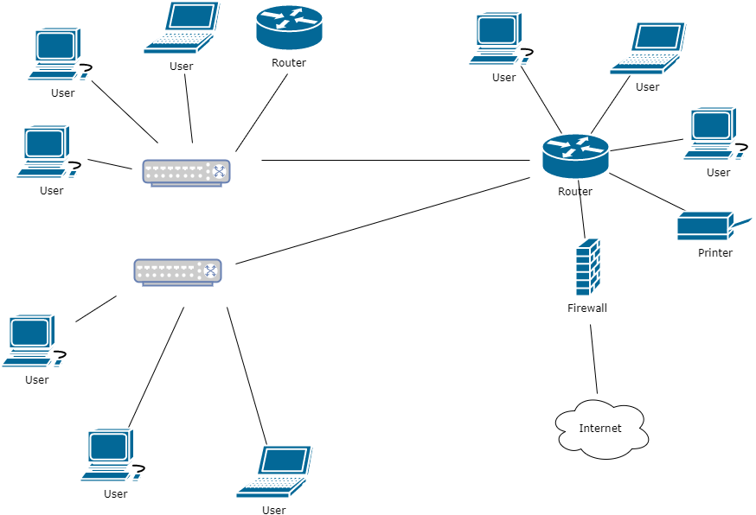

Slide 8
WAN vs LAN
LAN
A network that connects computers and devices in a limited area such as a home, school, or office building
WAN
A network that covers a broad area such as a city, country, or even global connections.
Main Difference
WAN connects local area networks to the internet.

Slide 9

Firewalls

Slide 10
What is a Firewall?
Network security device.
Monitors & filters network traffic.
Barrier between trusted & untrusted networks.
Allows/blocks data based on security rules.

Slide 11
Stateful vs Stateless Firewalls
Stateful Firewall
Remembers the state of active connections and makes decisions based on context
Stateless Firewall
Examines individual packets rather than the behavior of packets. Uses pre-set rules.

Slide 12
Different Types of Firewalls
Software Firewall
Installed on individual devices.
Hardware Firewall
A standalone device placed between a network and its connection to the internet
Cloud-based Firewall
Hosted in the cloud, offering scalable and flexible protection

Slide 13
How does a Firewall work?
Packet Filtering: Examines packets and allows/blocks based on source & destination IP, port numbers, and protocol.
Stateful Inspection: Monitors the state of active connections and makes decisions based on context.
Proxying: Acts as an intermediary, receiving requests and forwarding them on behalf of the requester.

Slide 14

Now to set up OPNsense

